Slide 1

Grocery Delivery Application
Presented By:
Leena Shinde.

Slide 2
Batch: 2021 – 6520
Under the Guidance of,
Chittaranjan Ghosh.
Technical Trainer
EduBridge
(School of coding)

Slide 3
Introduction:
A grocery store is a retail store that primarily sells food. A grocer is a bulk seller of food.
"Health is wealth”. As the saying goes from our ancient times. Eat healthy and stay healthy as of now a days its very difficult to have healthy food.
Grocery store managers must ensure that the store runs smoothly that items are priced comparatively and that customers are satisfied.
people are unable to find time to household works like buying grocery. So by this platform we provide grocery .
This is an Internet based application that can be accessed throughout the web.
This system can be used to search for all grocery and fresh vegetables which are available in the market

Slide 4
Modules:-
Shopping Management :This feature gives the system or the user the customers’ shopping information. This will serve as the basis of the admin on what to prepare or invokes the system to give the order of the customer.
Customer Management:This feature plays a big role for the system because this gathers the important information of the
customers. These information were used for determining the choices of the customer orders and their transactions.
Manage Transactions :In this feature, the admin can have and monitor the transactions that are made by the customers. This will save the transaction information as well as the important matters that were done during shopping like ordering and paying.
Transaction and Reports Management:
This feature will store the transactions made including their information and the reports every transactions in the corresponding timetables.

Slide 5
Software Requirements:
I have developed this Application in Java, JSP, Servlets, Hibernate and MySQL. It’s a web-based projects so I have used HTML, CSS, JavaScript and Bootstrap ,Thymleaf.
Front end: Java/J2EE technologies , HTML, CSS, JavaScript, Bootstrap, Thymleaf, Hibernate.
Back end: MySQL workbench 8.0 CE.
Middleware/Server: Apache Tomcat v8.5. IDE: Spring tool suite for Java EE Developers
Browser: Best result on Google Chrome
Operating System: Linux

Slide 6
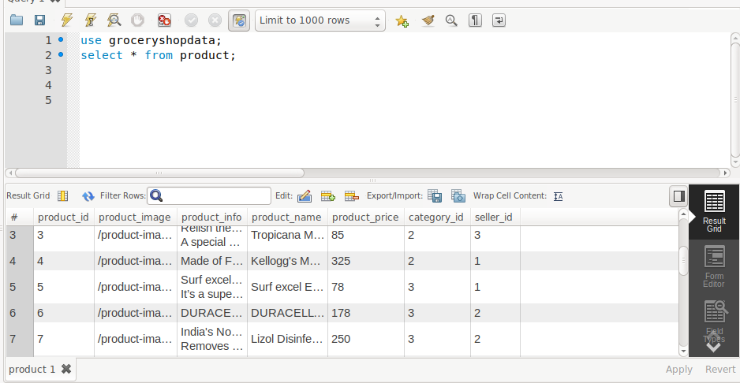
Data Dictionary:

Slide 7
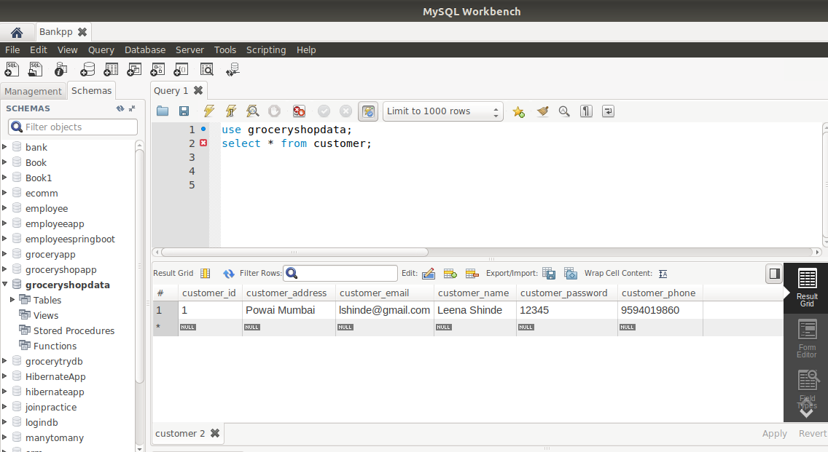
Customer Table:

Slide 8

Transaction Table :

Slide 9
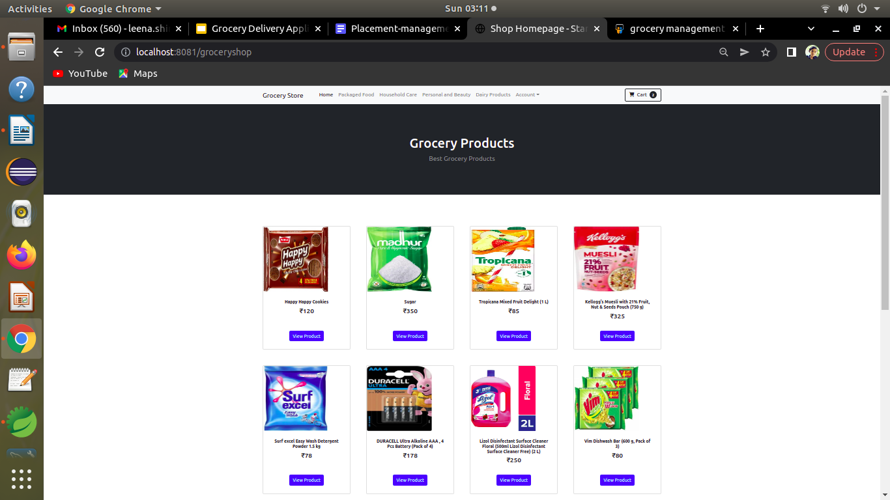
Screenshots :
Home Page

Slide 10
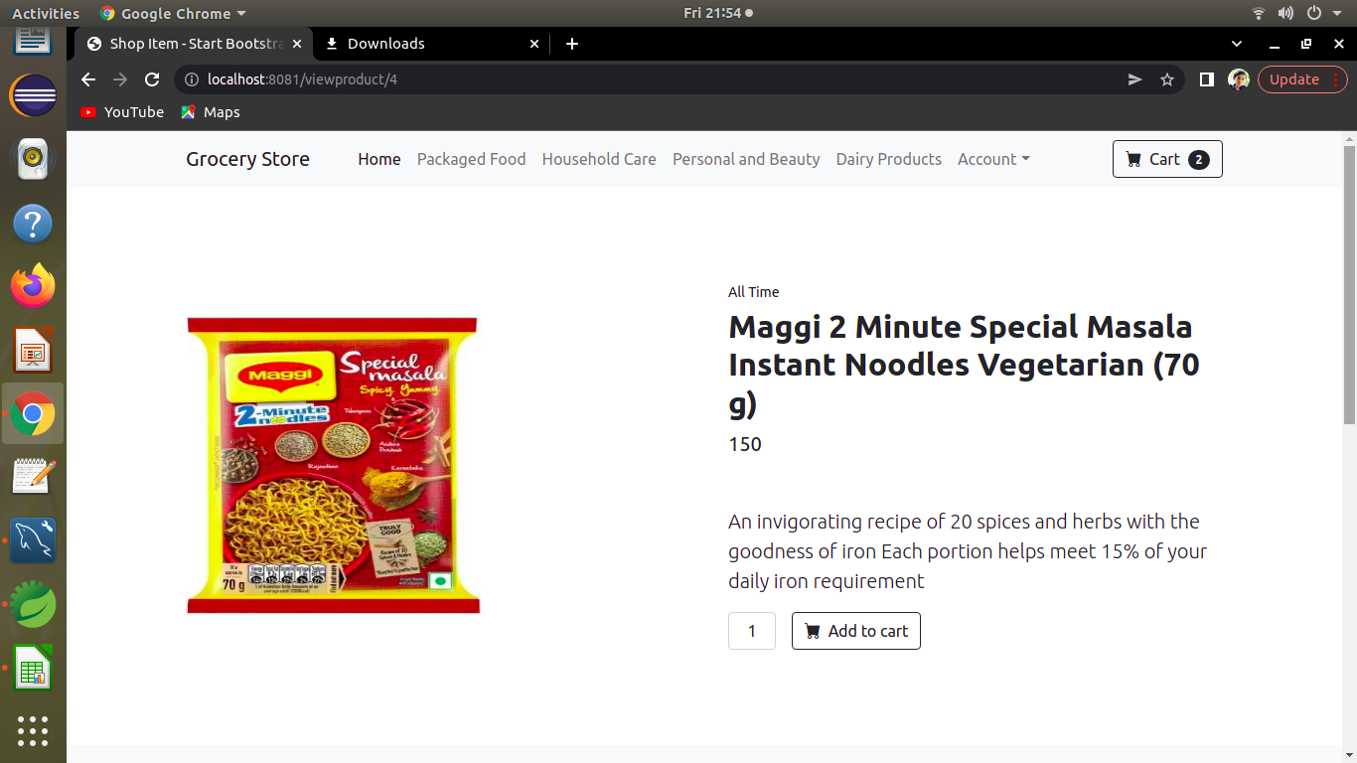
Single-Product Page:

Slide 11
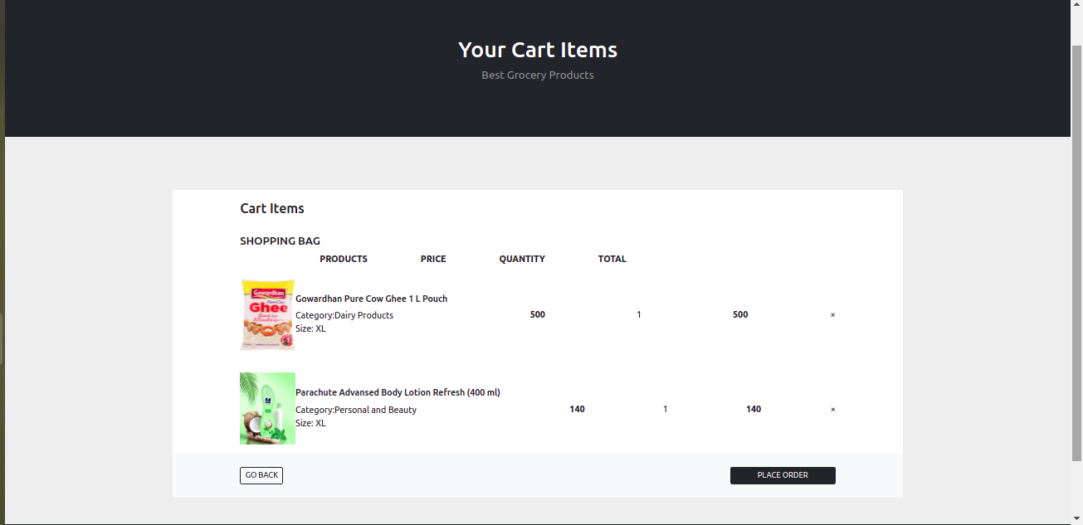
Cart-Product Page:

Slide 12
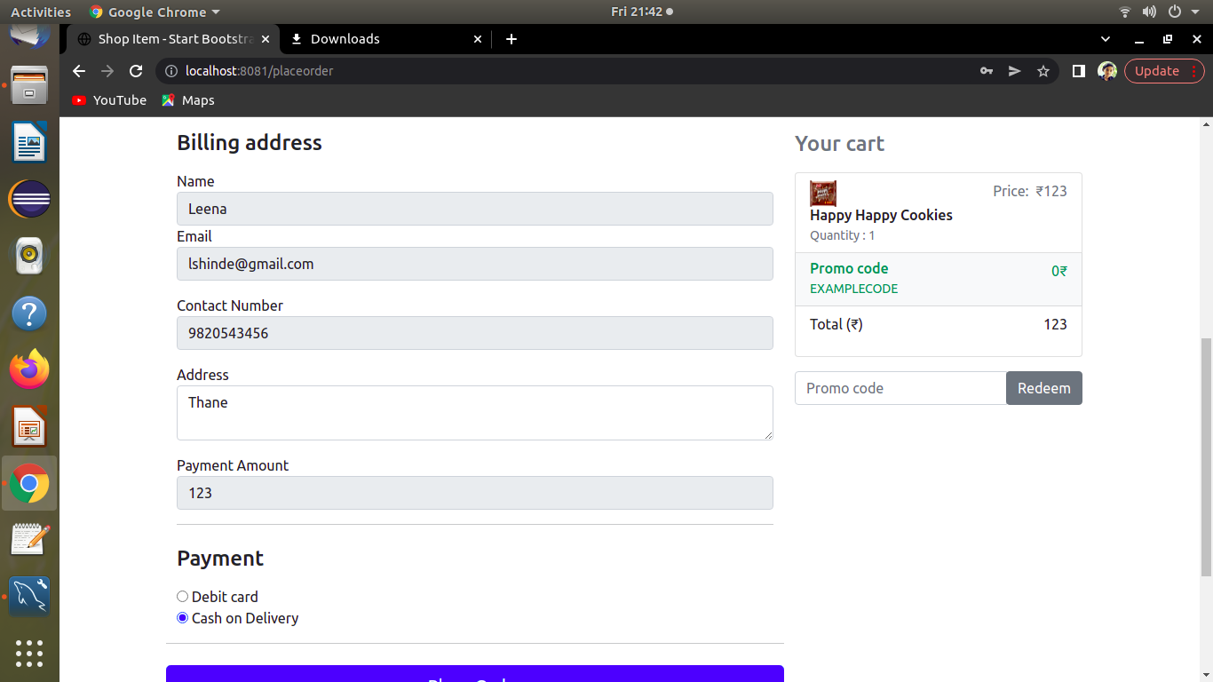
Place-0rder Page:

Slide 13
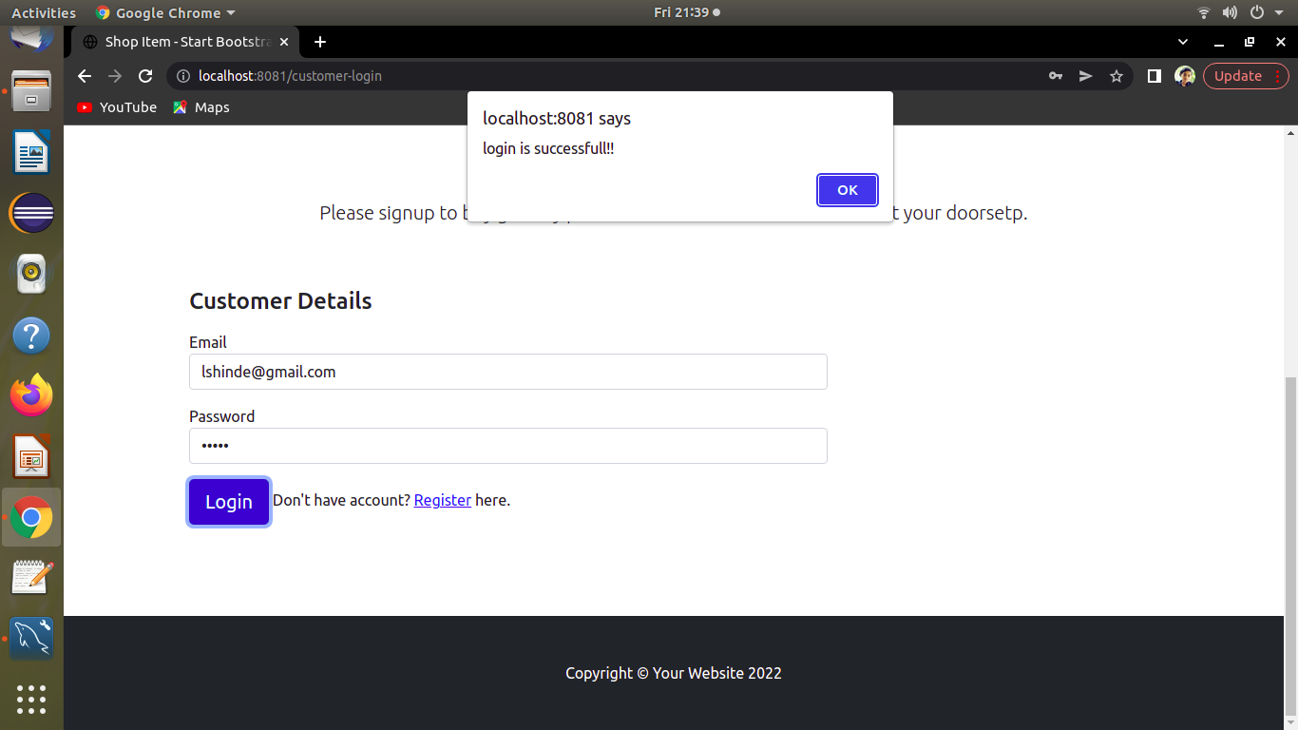
Customer Login Page:

Slide 14
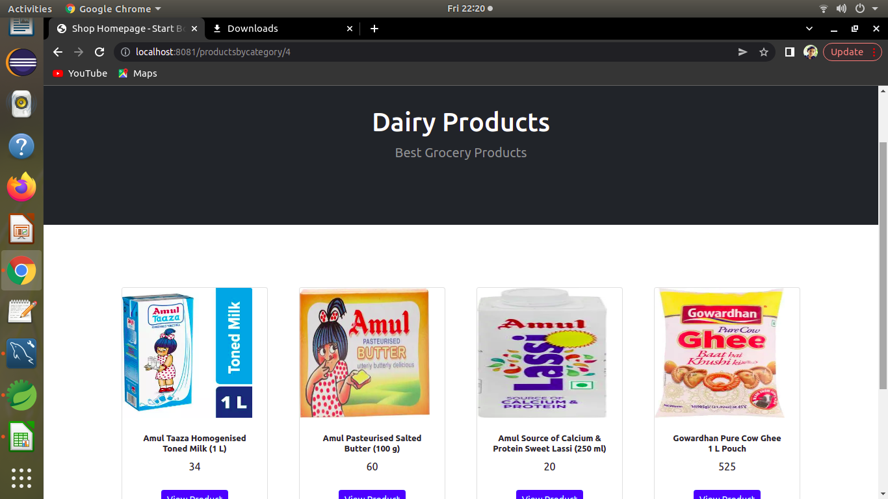
Category Page:

Slide 15
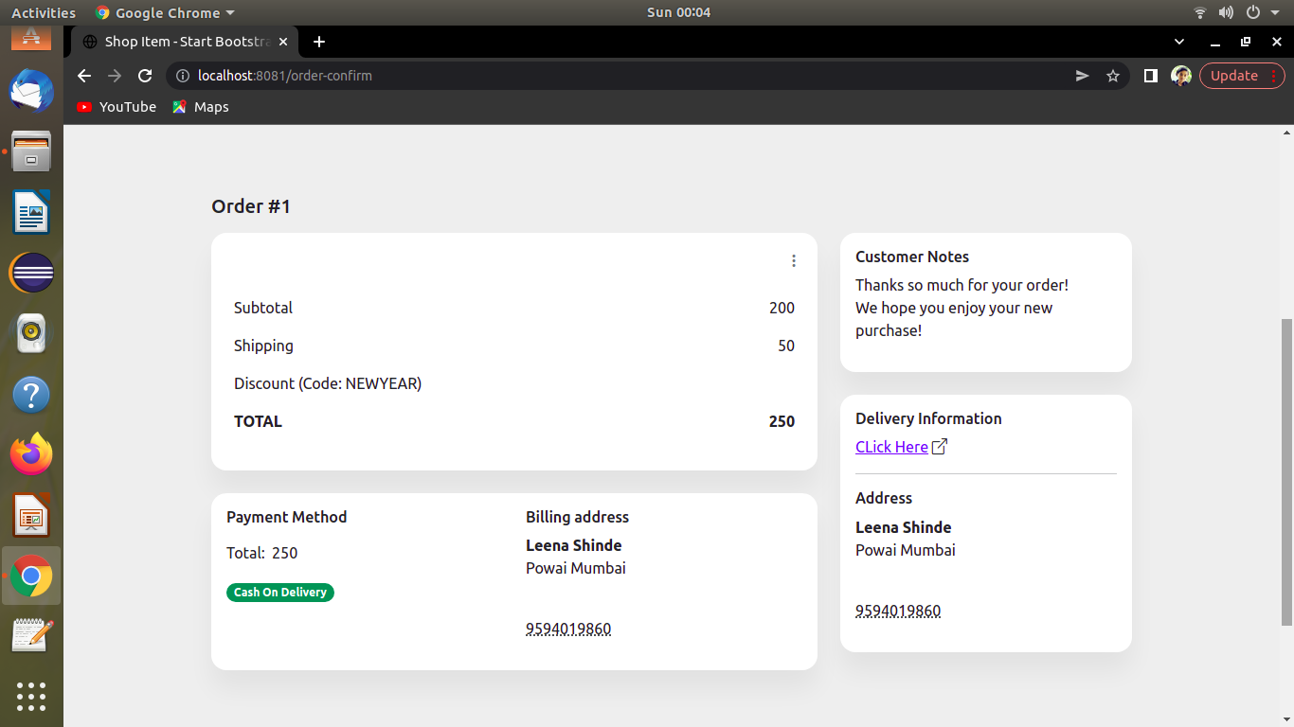
Order Confirmation Page :

Slide 16
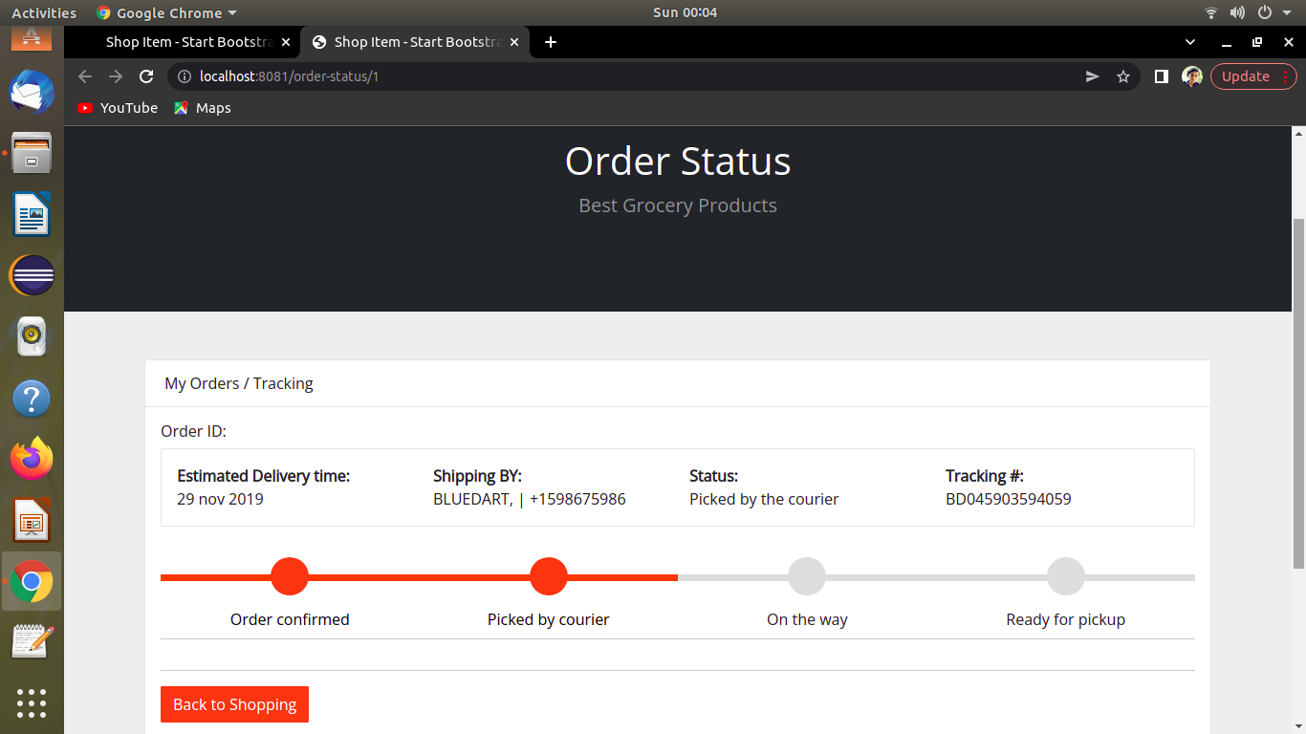
Order Status Page:

Slide 17
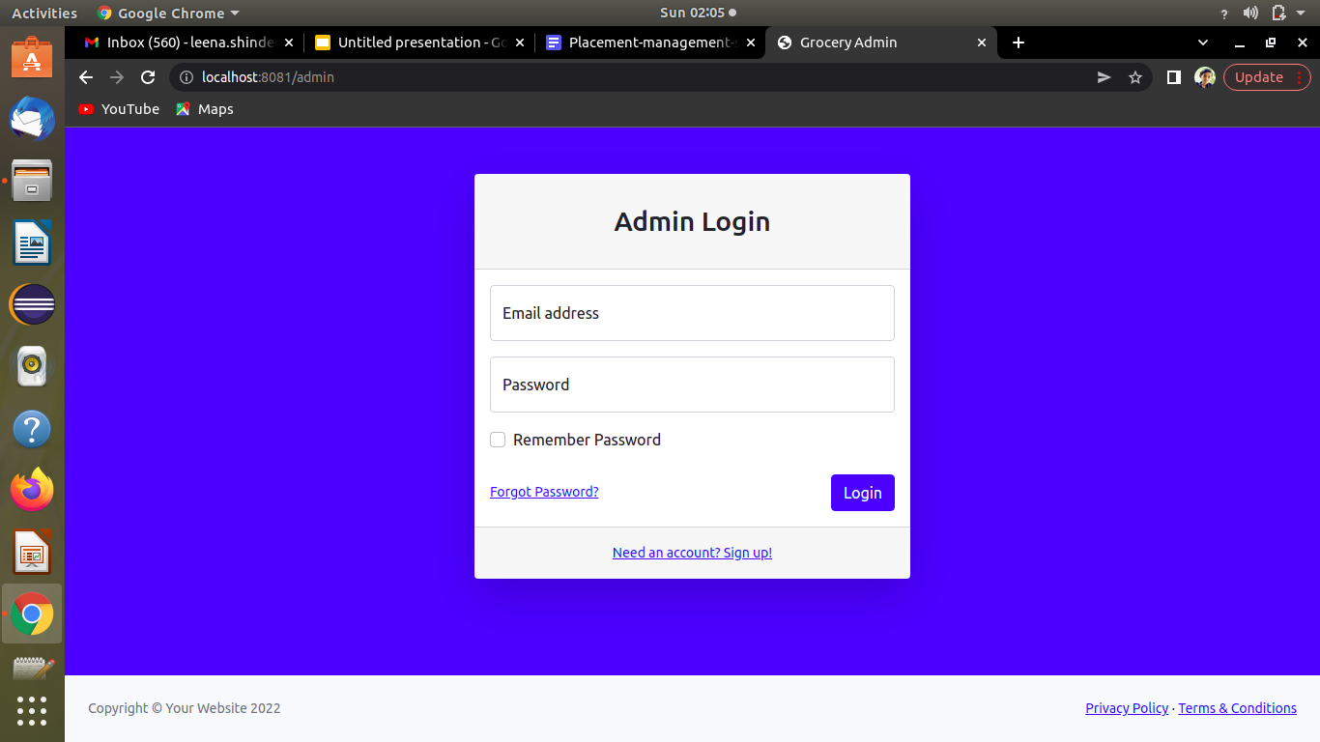
Admin Login Page:

Slide 18
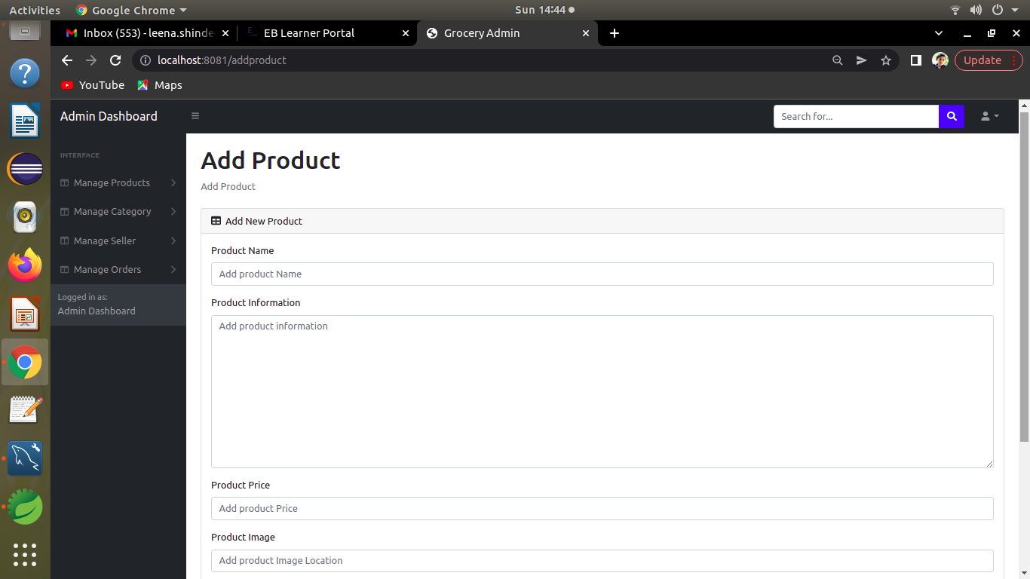

Slide 19
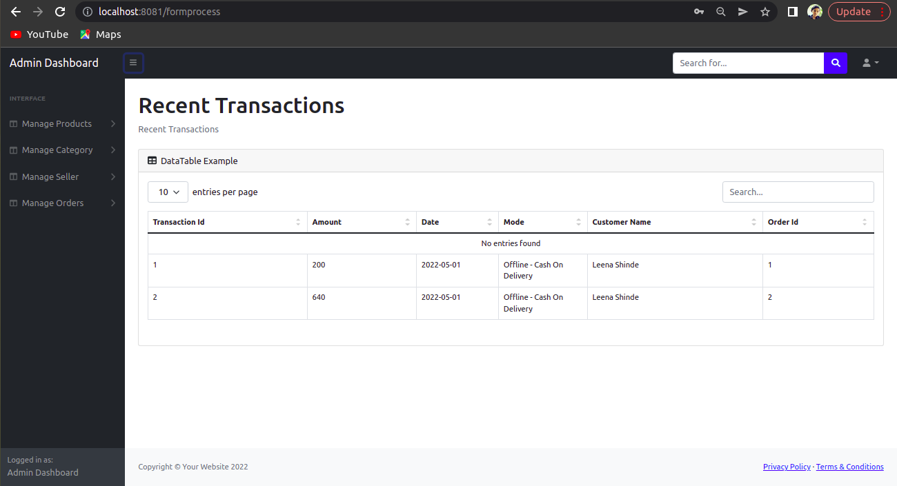

Slide 20
Thank You.

